Slide 1
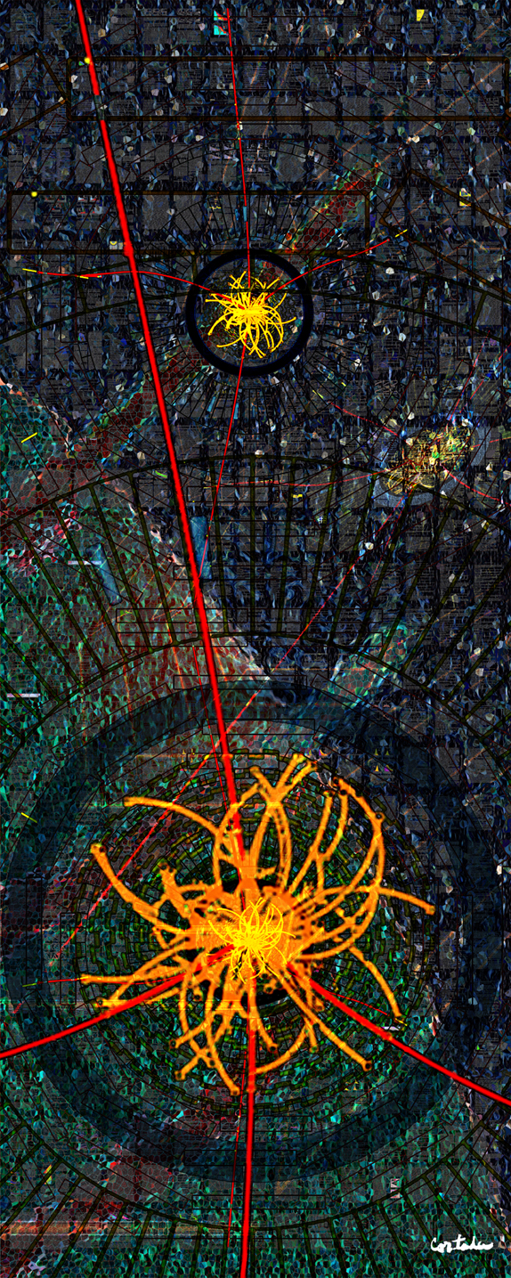
Tests of the Electroweak Theory with the CMS Experiment
UC HEP Seminar
October 7, 2013
Jeffrey Berryhill (Fermilab)
On behalf of the CMS collaboration
Digital art courtesy of Xavier Cortada (with the participation of physicist Pete Markowitz) "In search of the Higgs boson: H -> ZZ"

Slide 2
Electroweak Physics at CMS
~30 topics dealing with various aspects of single and multiple electroweak boson production spanning three subgroups of the CMS Standard Model group
Most all topics have been addressed with ~5/fb at sqrt(s) = 7 TeV
Some (esp. diboson cross sections) have been addressed with ~20/fb at sqrt(s) = 8 TeV
The Run 1 results are now superseding LEP and Tevatron results in the multi-boson domain
Potential for improving precision electroweak measurements is under investigation
To set the scale: CMS Run 1 Z dilepton sample now exceeds all the Z’s of LEP 1 (~20 million)
Outline for today
Z and Drell-Yan Physics
Cross sections
AFB
Sin²θ_{eff} & prospects
W Physics
W asymmetry
W+charm
W mass prospects
Diboson Physics and aTGCs
Dim 6 gauge boson EFT
Cross sections
TGCs
Tribosons, VBS, and aQGCs
WVγ search
WWγγ scattering
VBF Z production
https://twiki.cern.ch/twiki/bin/view/CMSPublic/PhysicsResultsSMP

Slide 3
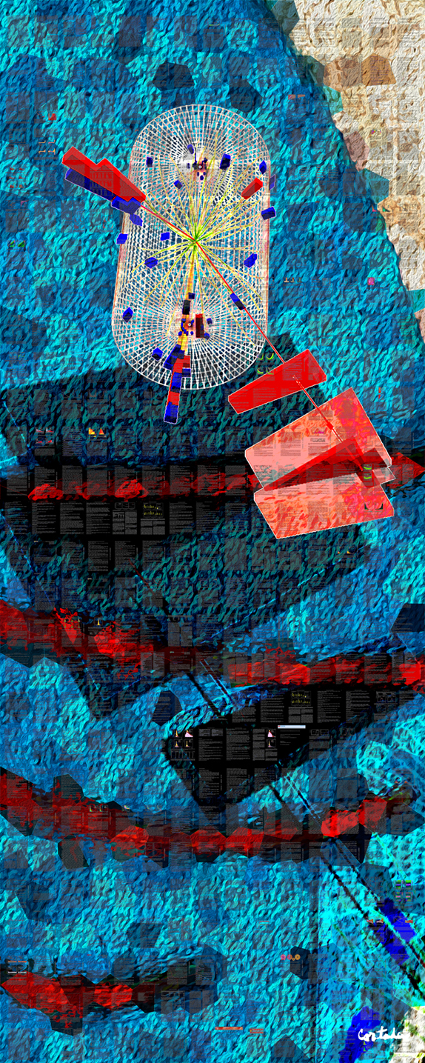
Z and
Drell-Yan Physics
Digital art courtesy of Xavier Cortada (with the participation of physicist Pete Markowitz) "In search of the Higgs boson: H -> tautau"

Slide 4
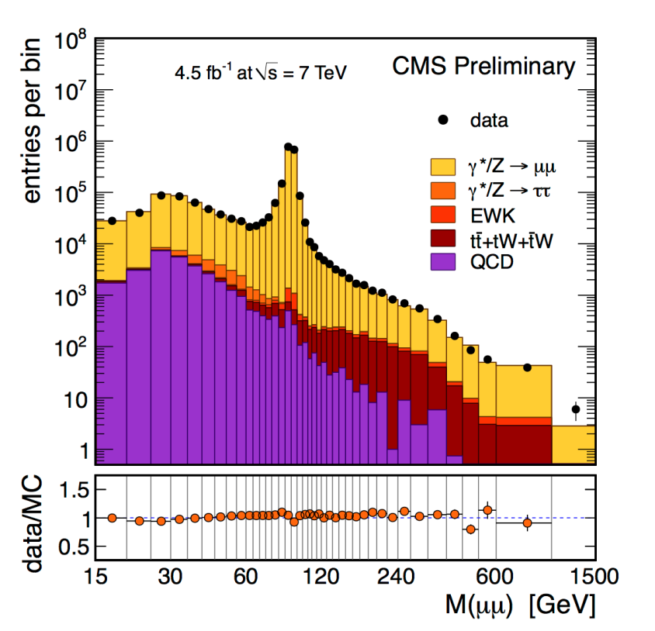
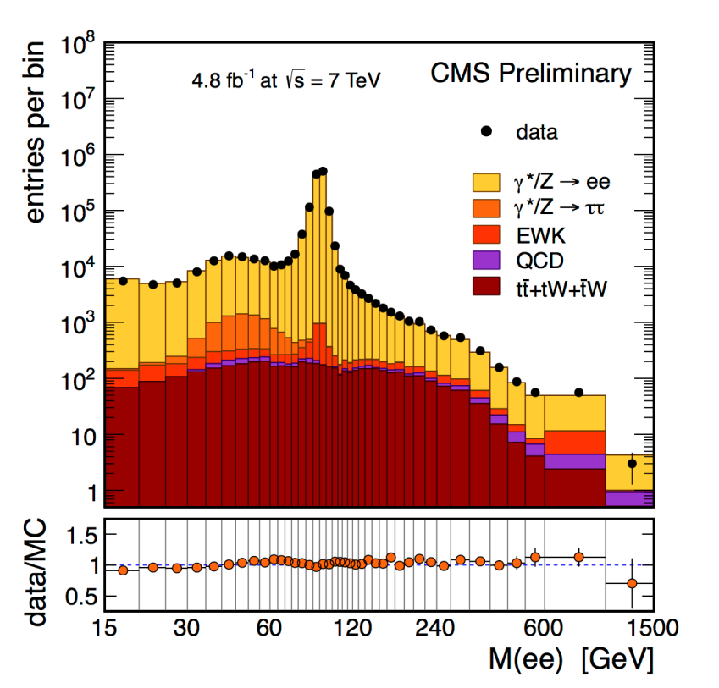
Z and Drell-Yan Production at LHC
CMS-PAS-SMP-13-003
Z/Drell-Yan production at LHC gives us 1M dilepton events/fb with high efficiency and purity
Collected with 14/9 GeV muon PT and 20/10 GeV electron PT offline selection, with muon (electron) |η| < 2.4 (2.5)
Efficiency estimated in situ using “tag-and-probe” methods
Small backgrounds from emu and same-sign control samples

Slide 5
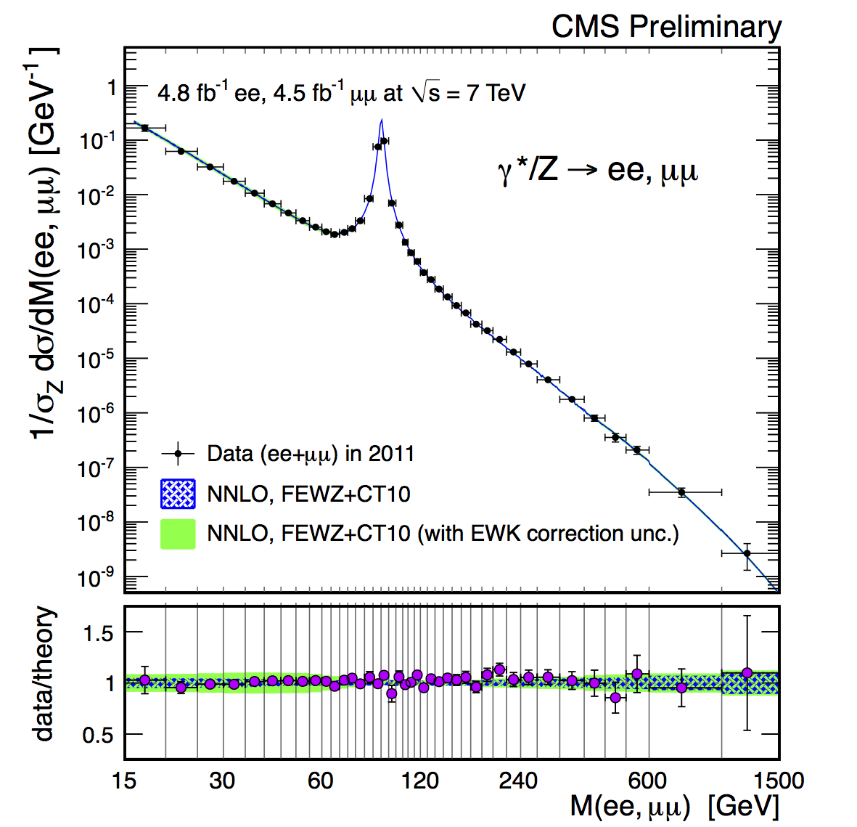
Z and Drell-Yan Production at LHC
CMS-PAS-SMP-13-003
Differential cross section vs. mass measured at 7 TeV, from 15-1500 GeV in mass.
ee, mumu in agreement with each other and with the Standard Model
NNLO QCD corrections are important at low mass (mostly boosted events)
NLO EWK corrections and photon-induced production (green band) now important at all masses. Photon PDF (NNPDF 2.3) is now needed!

Slide 6
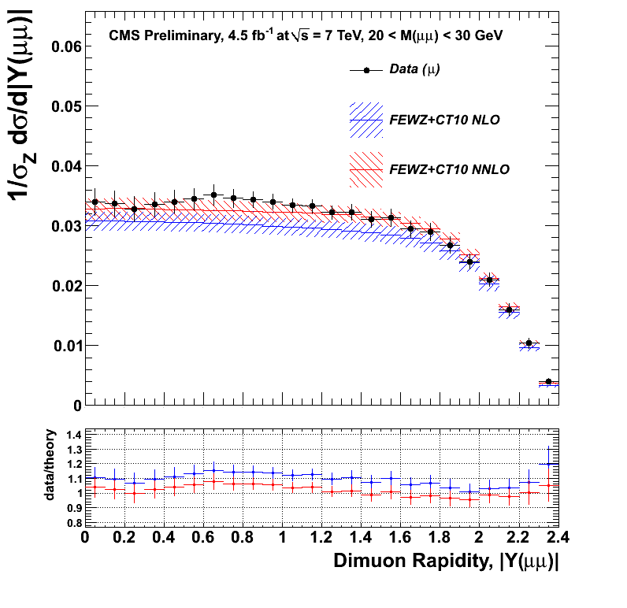
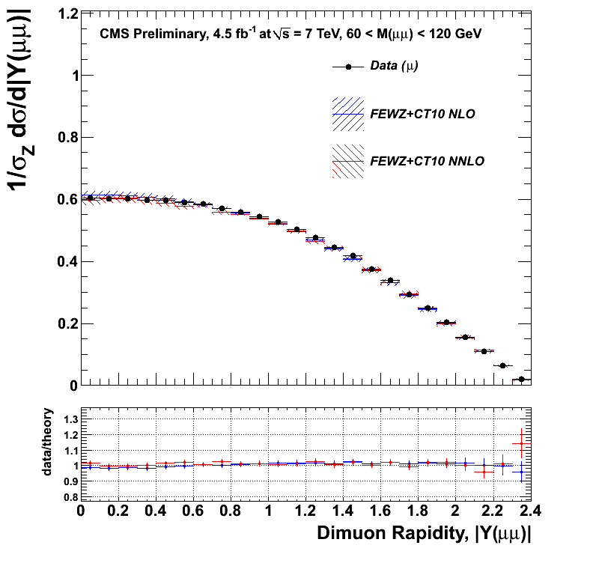
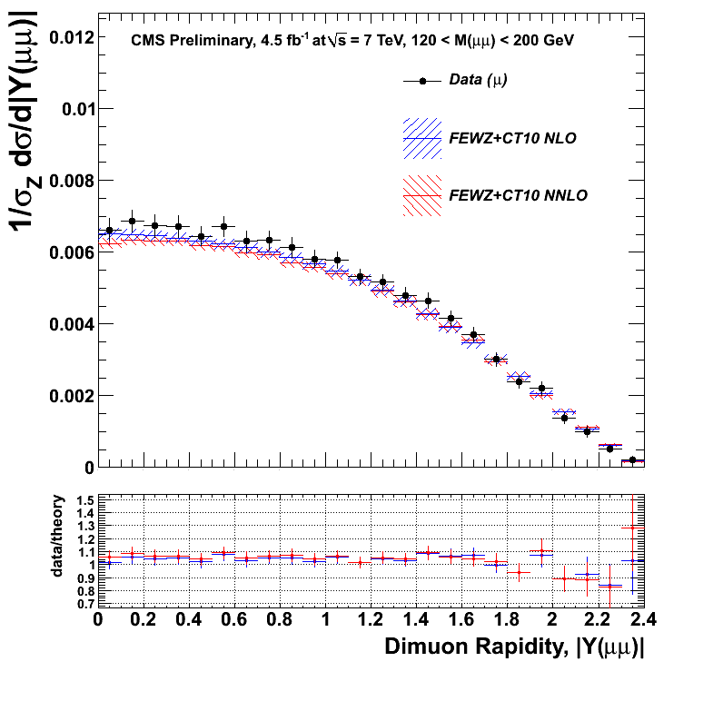
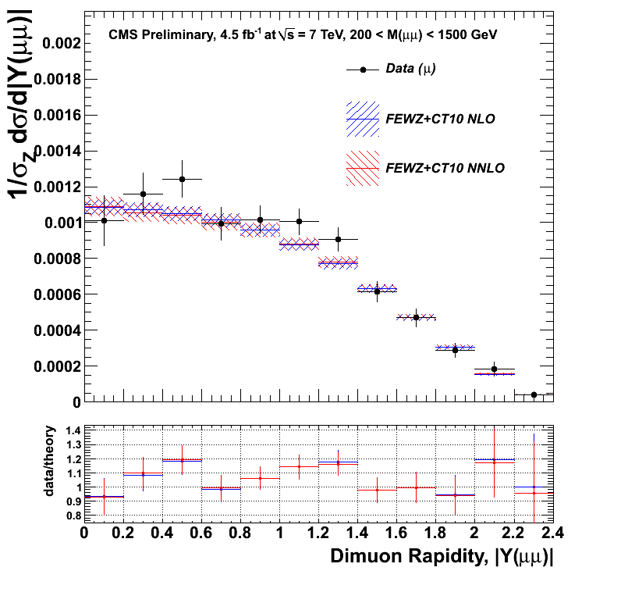
Z and Drell-Yan Production at LHC
CMS-PAS-SMP-13-003
Double-differential cross section in M and y measured for the first time at LHC (dimuons only)
Unfolded to the pre-FSR “Born level”
NNLO QCD effects are visible at low mass
Expected to have an impact on sea quark PDFs
Combined with W data, can extract strange quark PDF

Slide 7
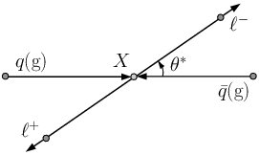
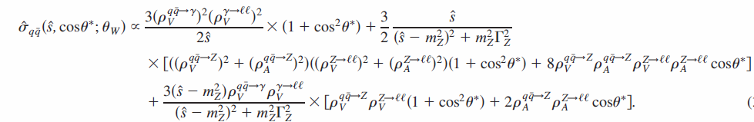
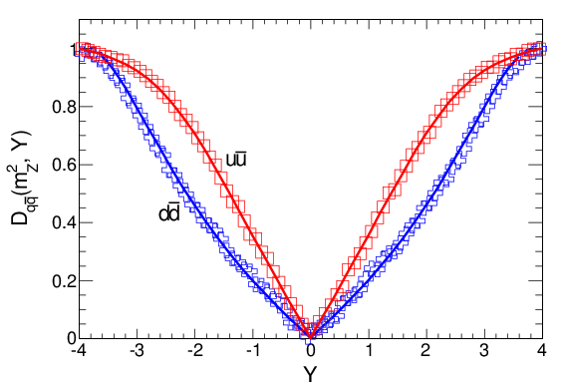
Angular distributions and the weak-mixing angle
In the dilepton CM, lepton angle with respect to axis of quark momentum is sensitive to interference effects: vector with axial-vector Z couplings, Z with photon, or Z with new physics
V-A int. ~ sin²θ_{eff} -1/4
Z-photon int.
This relation is diluted in real proton collisions, where a Collins-Soper frame choice of cos θ* often guesses the quark axis wrong.
Forward dilepton production has stronger correlation of Collins-Soper cos θ* with quark-level cos θ*
Suppression of odd cos θ*
term due to dilution

Slide 8
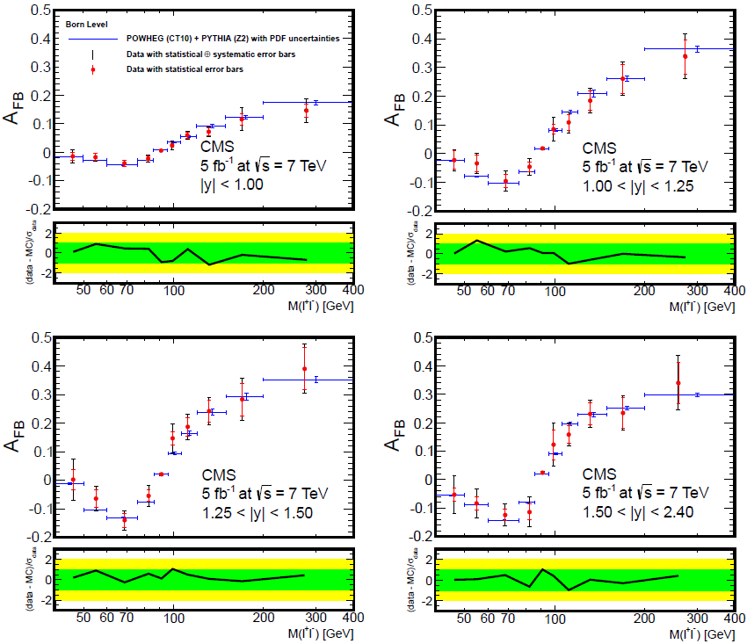
Forward-Backward Asymmetry vs. M,Y
Phys. Lett. B 718 (2013) 752
Unfolded AFB vs. dilepton mass measured in four slices of dilepton rapidity.
Less diluted AFB seen at higher y
Correct photon-Z interference observed above and below MZ
SM-like small AFB seen at MZ

Slide 9
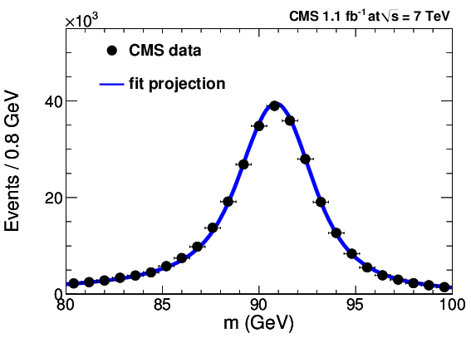
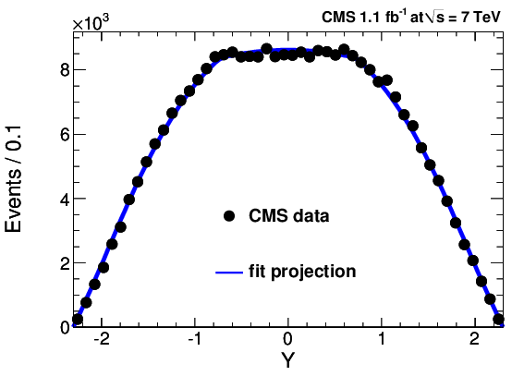
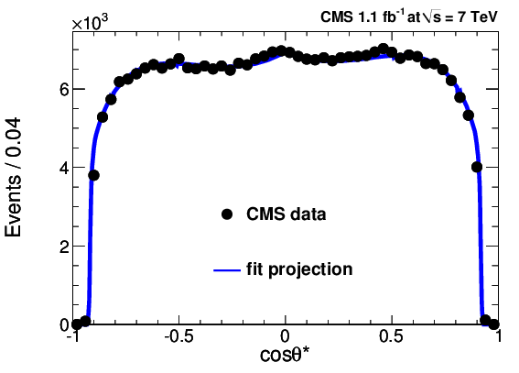
Weak-mixing angle
CMS, Phys. Rev. D 84 (2011) 112002
Zooming in on MZ region, full kinematic correlations exploited to estimate sin²θ_{eff}
1D projections of 3D fit for sin²θ_{eff} using m, y, cos θ*describe the data well

Slide 10
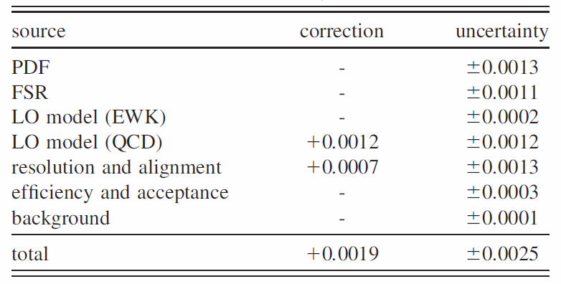
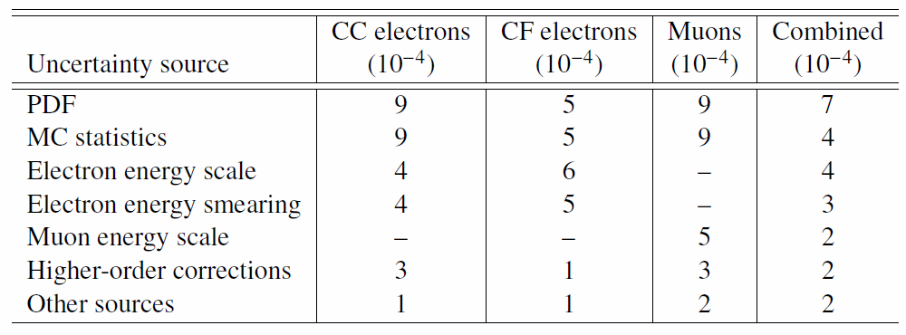
Weak-mixing angle prospects for Run 2
CMS, Phys. Rev. D 84 (2011) 112002
Need a 10X better measurement to achieve world-average precision
Statistical error for dimuon channel alone hits this target with 100/fb @ 13-14 TeV
PDF uncertainty is biggest concern, needs >10X improvement from LHC data
Momentum scale must also improve 10X
Forward electrons have superior stat. and PDF error. Will energy scale scale?
ATLAS-CONF-2013-043

Slide 11
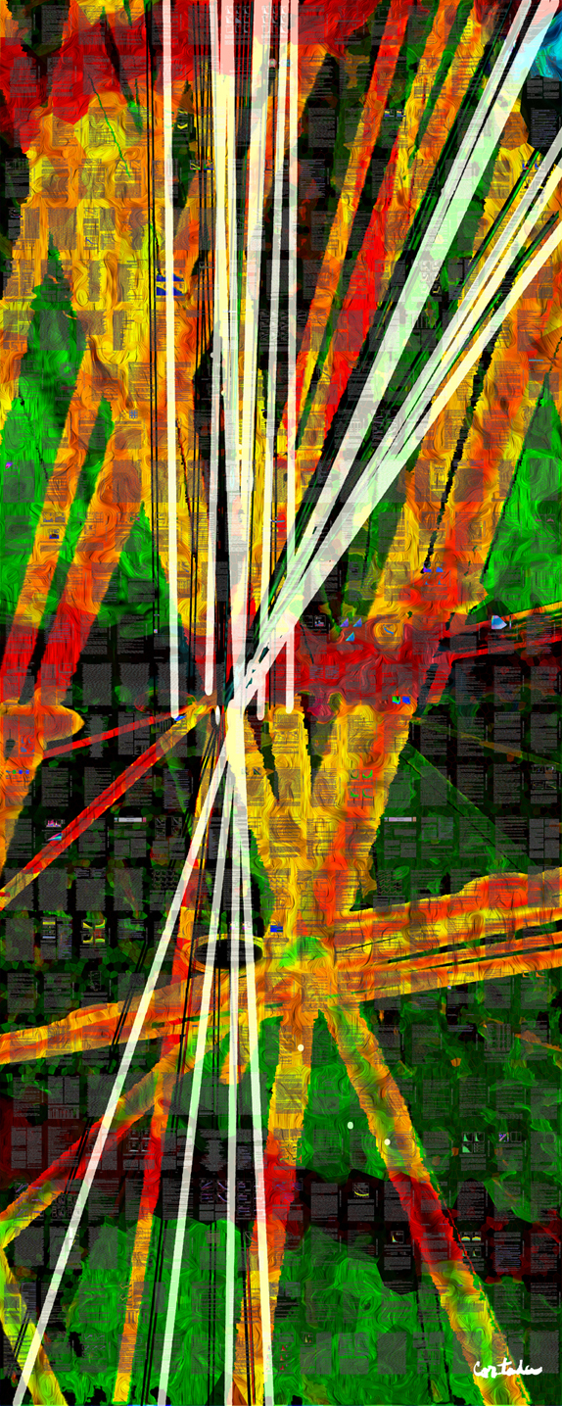
W Physics
Digital art courtesy of Xavier Cortada (with the participation of physicist Pete Markowitz) "In search of the Higgs boson: H -> bottom bottom"

Slide 12
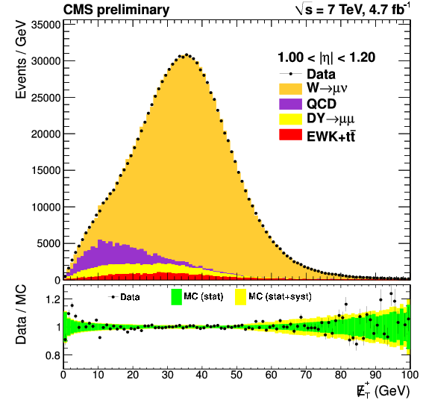
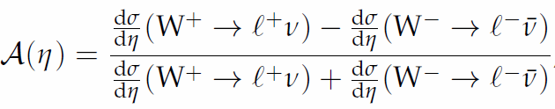
W charge asymmetry
CMS-PAS-SMP-12-021
At 7 TeV, ~4M W muon candidates produced per /fb with high purity and efficiency, for PT > 25 GeV and |η| < 2.4
W production is majority valence-sea quark collisions, with some sea-sea and higher order diagrams with gluons
Protons are 2:1 u:d valence, and sea is mostly charge-symmetric, so roughly 2:1 W+:W- produced
Sea-sea and gq dilute this effect to be somewhat less than 2:1, with variation in x (corr. with muon |η|)
Differential W charge asymmetry precisely probes u/d ratio vs. x, strong constraint on PDFs

Slide 13
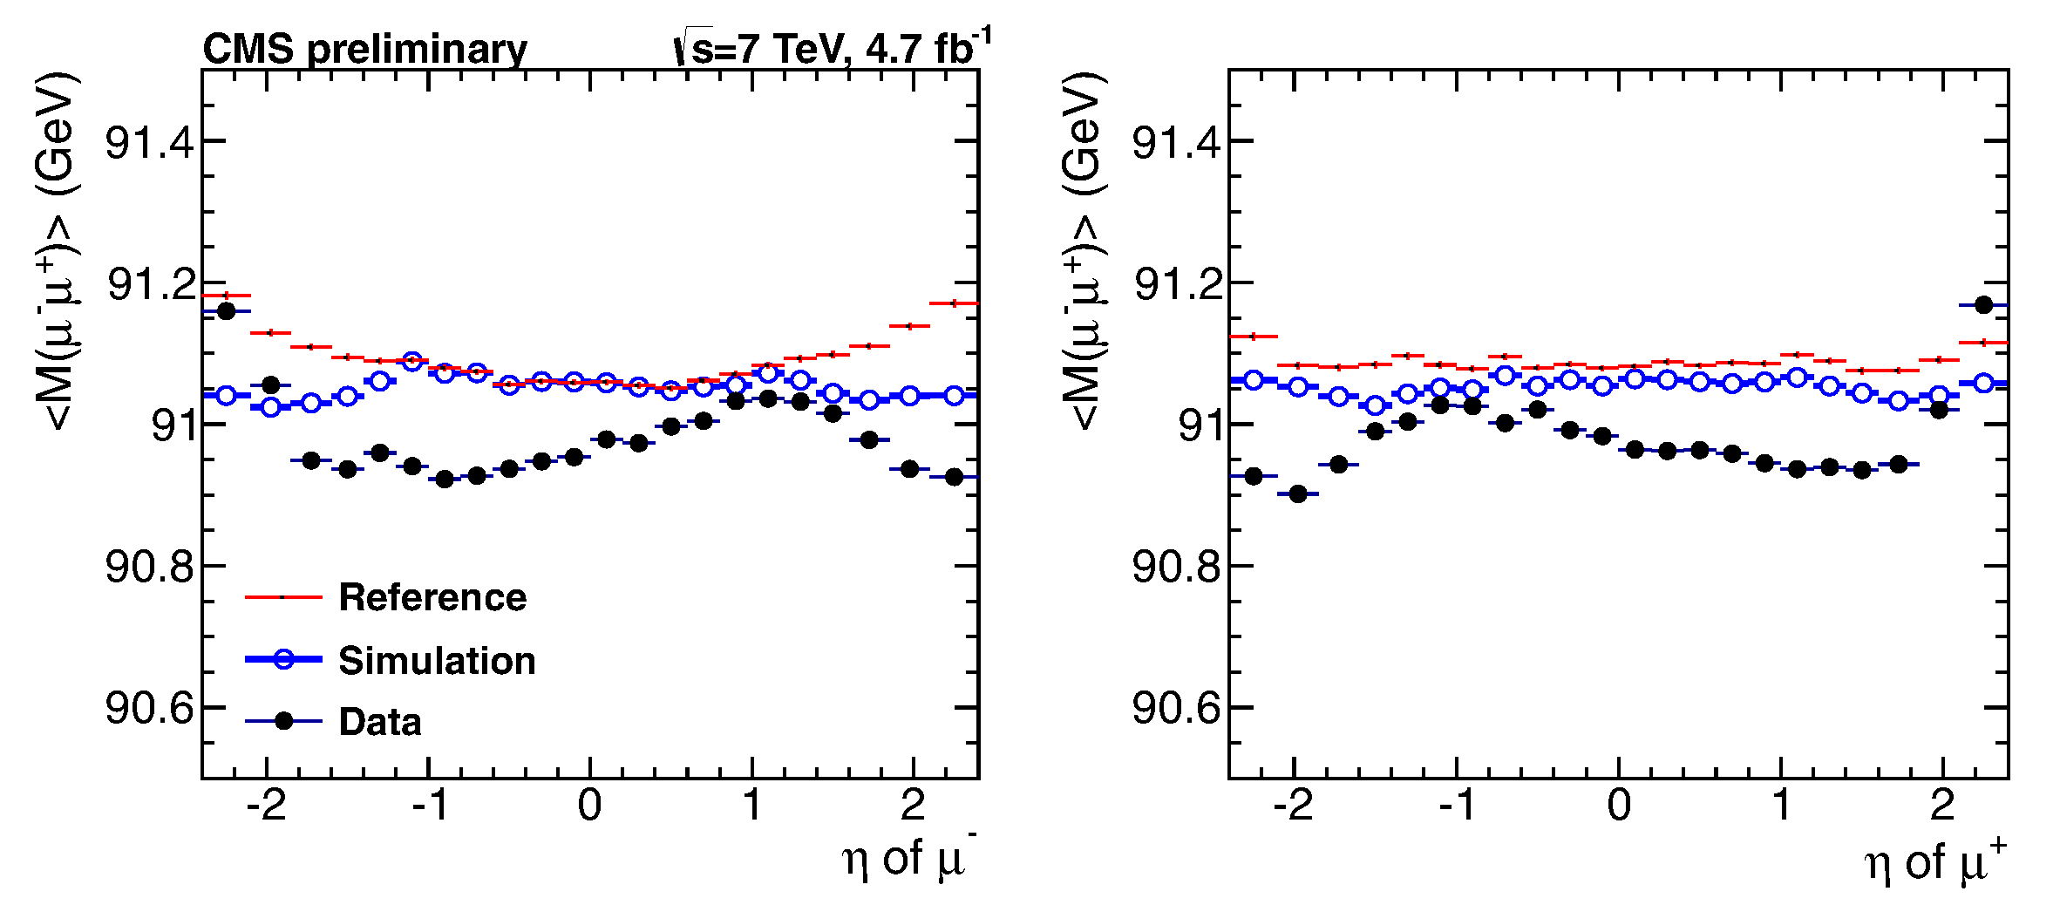
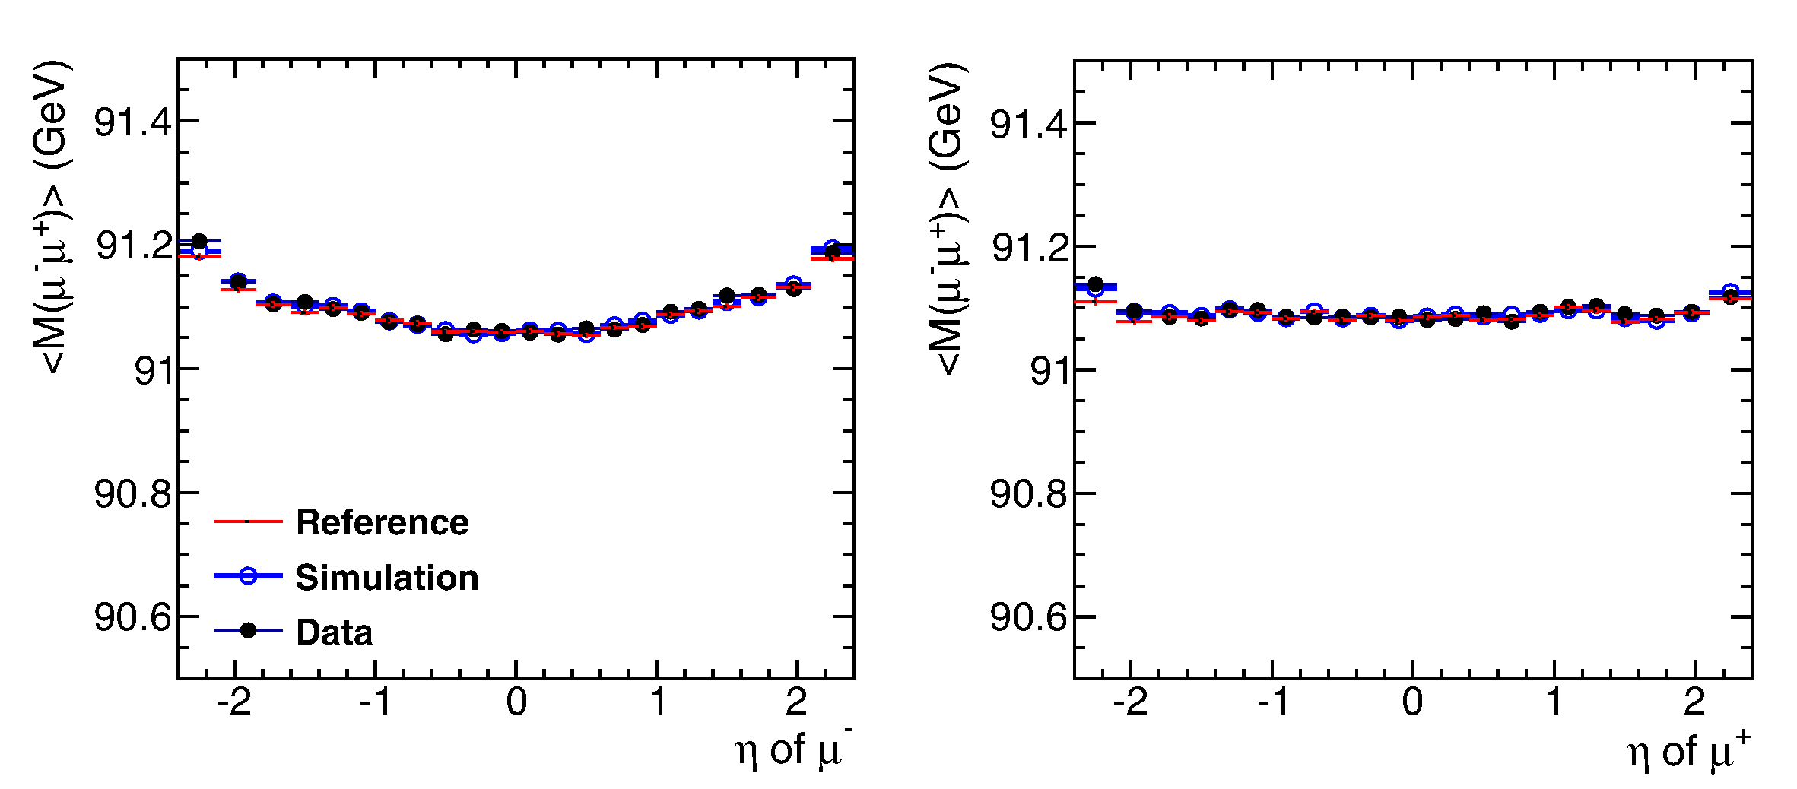
W charge asymmetry
CMS-PAS-SMP-12-021
Precise W counting requires sharp knowledge of muon PT acceptance
Curvature of Z muons are calibrated against reference <1/PT> as a function of charge and η, φ
Curvature corrected further to match expected MZ. Iteratively converges to final calibration
Afterwards, η, φ closely match MC generator reference
Mu- before
Mu+ before
Mu- after
Mu+ after

Slide 14
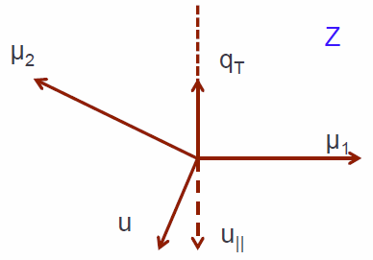
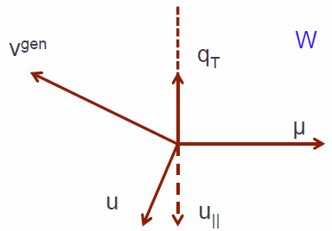
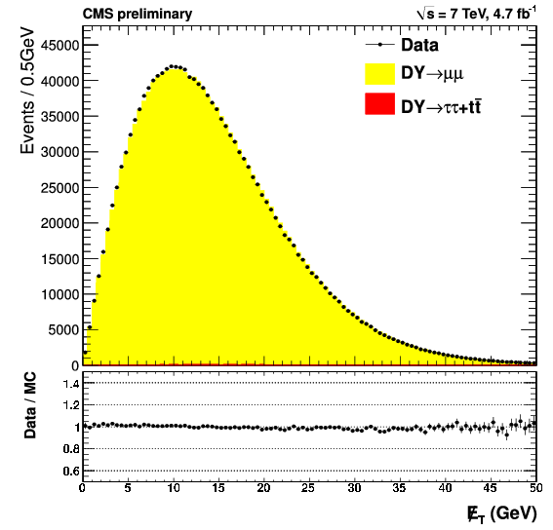
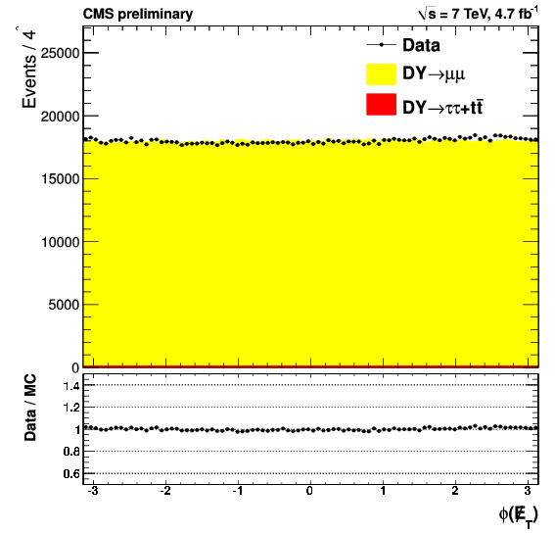
W charge asymmetry
CMS-PAS-SMP-12-021
Signal-background separation requires precision W recoil model
Recoil u(perp) and u(para) mean and width measured in Z sample vs. Nvtx, η(jet), qT
Z/Drell-Yan “MET” and “MET φ” precisely recovered after data/MC corrections of recoil model
W recoil model receives same data/MC scalings of u

Slide 15
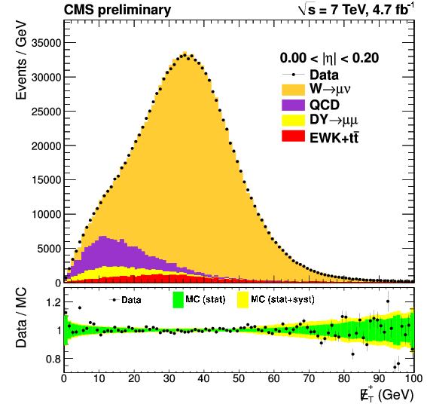
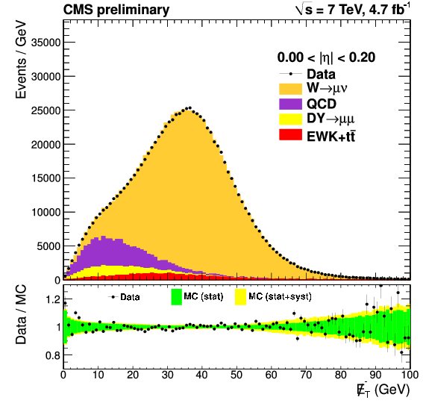
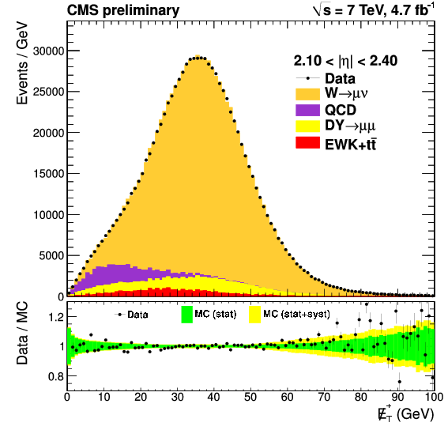
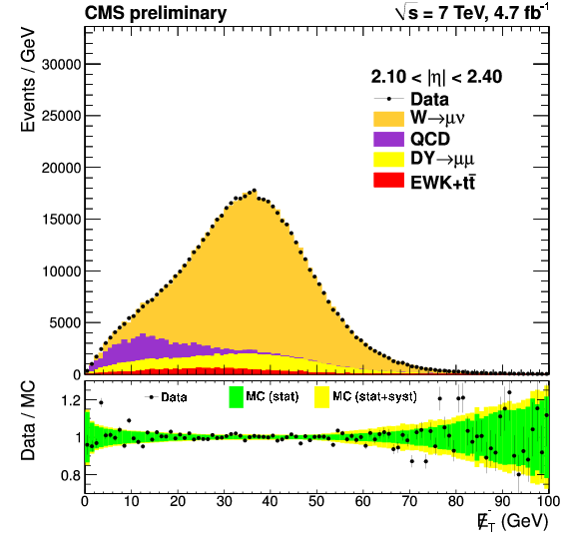
W charge asymmetry
CMS-PAS-SMP-12-021
W count vs. charge and 11 bins in |η| extracted from LH fit to MET. ~1 M events in each fit!
Signal template is W fullsim with MET and mu scale corrections
QCD background template from non-isolated mu
Excellent fit quality across a wide range of MET and η
Mu+
Mu-
Mu+
Mu-

Slide 16
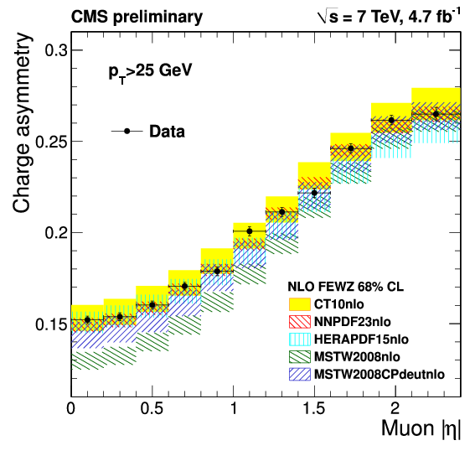
W charge asymmetry
CMS-PAS-SMP-12-021
W yields corrected for possible efficiency asymmetry measured from Z (leading uncertainty)
Asymmetry measured to 0.1% absolute per bin, with only small inter-bin correlations
Disagreement with original MSTW2008 led to reformulation of valence x-dependence
Has obvious constraining power for all PDF families

Slide 17
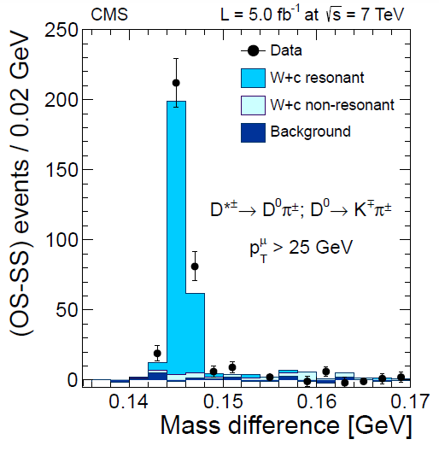
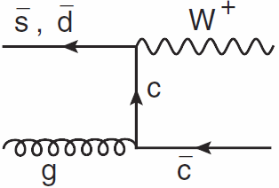
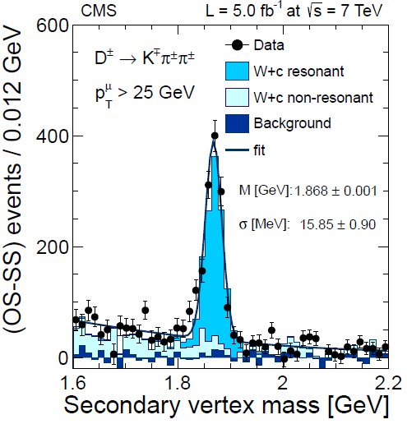
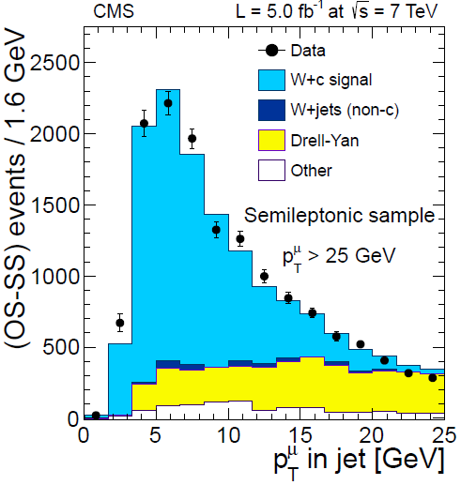
W+charm cross section
arXiv:1310.1138
Leading order W+c directly probes strange quark PDF
Strange and anti-strange probed independently by W+, W-
W and c are opposite sign
Higher-order W+cc, W+bb, top are same-sign/opposite-sign symmetric→subtract with same-sign data
(semi-)exclusive charm hadron reconstruction gives high-purity, self-charge-tagged W+c samples

Slide 18
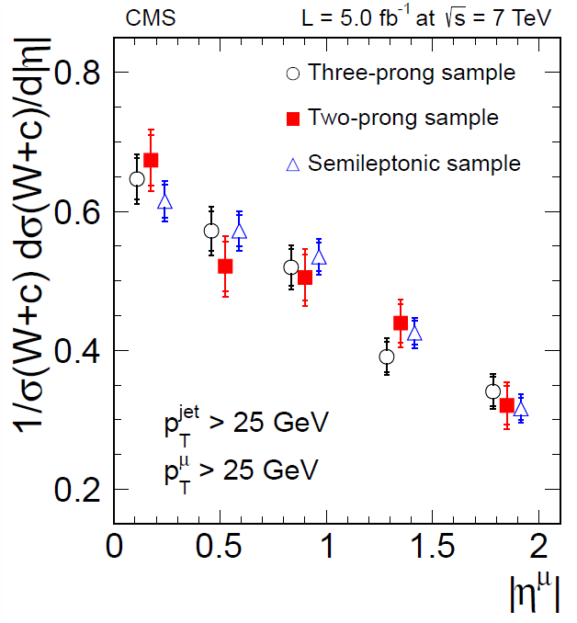
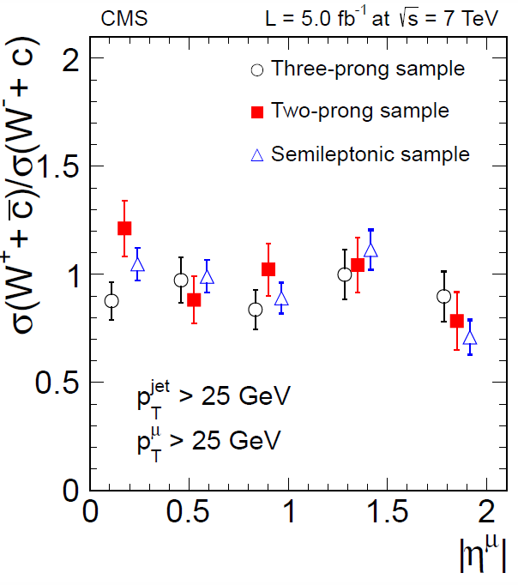
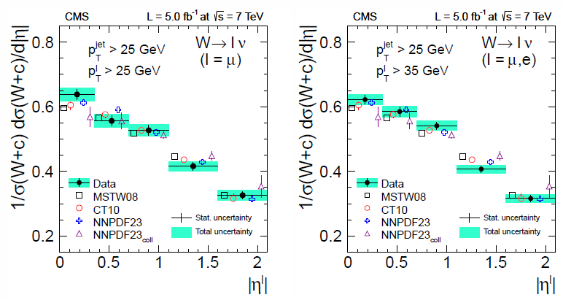
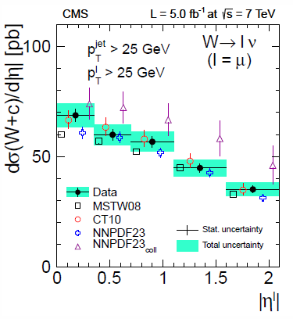
W+charm cross section
arXiv:1310.1138
Measure cross section and charged ratio vs lepton |η|
Consistent across three different hadron reco methods
Leading syst. are JES, charm branching fractions
Consistent with NLO MCFM predictions

Slide 19
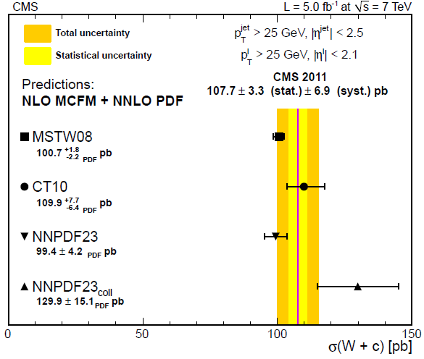
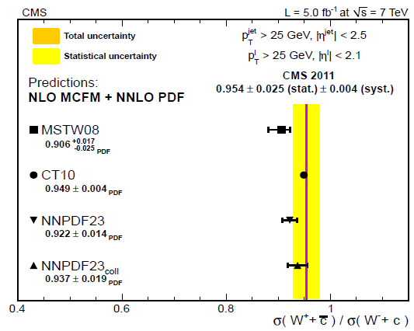
W+charm cross section
arXiv:1310.1138
Data consistent with strange content of pre-LHC PDFs (neutrino fixed-target), approaching good precision
Some tension with analogous ATLAS result, which prefers more strangeness
Data consistent with charge symmetric strange PDF

Slide 20
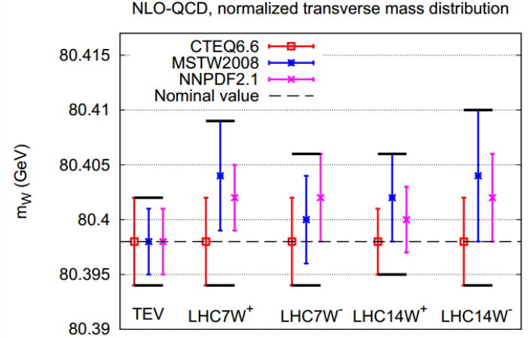
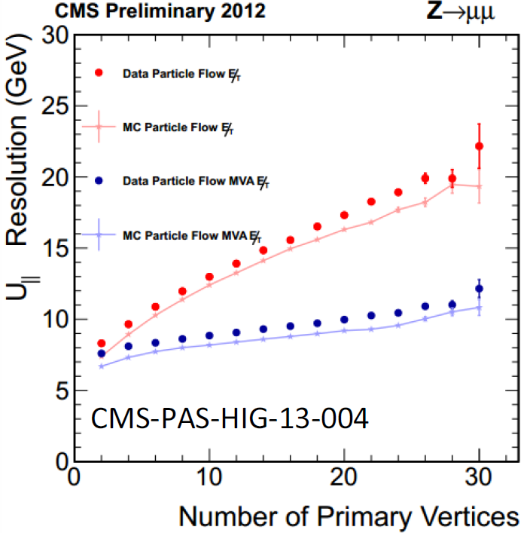
Prospects for W mass measurement
The LHC has excellent detectors and semi-infinite statistics and thus has a good a priori prospect for a <10-MeV measurement
Biggest three obstacles to surmount:
PDFs: sea quarks play a much stronger role than the Tevatron. What are the limiting d.o.f. and can they be measured in situ?
Momentum scale: current determination is not competitive. Identify limiting factors (FSR).
Recoil model: Can a precision model be constructed with higher pileup data? With usable MET resolution?
Phys.Rev.D83:
113008,2011

Slide 21
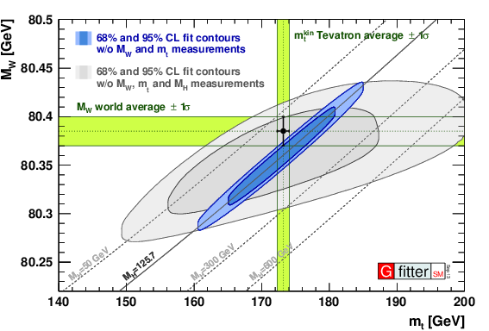
Prospects for W mass and weak mixing angle
http://project-gfitter.web.cern.ch/project-gfitter/
SM-like Higgs discovery
at ~125.7 GeV is compatible
with global EWK data
at 1.3 sigma
Global p-value of all data is 18%

Slide 22
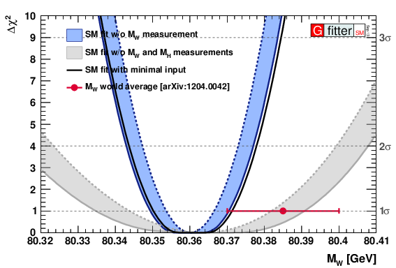
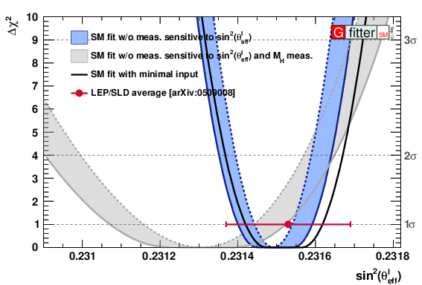
Prospects for W mass and weak mixing angle
http://project-gfitter.web.cern.ch/project-gfitter/
MW is predicted to 11 MeV indirectly,
Thus <10 MeV direct precision is motivated to further resolve any differences
sin²θ_{eff} is predicted to 1.0 10-4 indirectly,
(1.6 10-4 directly from LEP+SLD)
Thus <1 10-4 direct precision is motivated to further resolve any differences

Slide 23
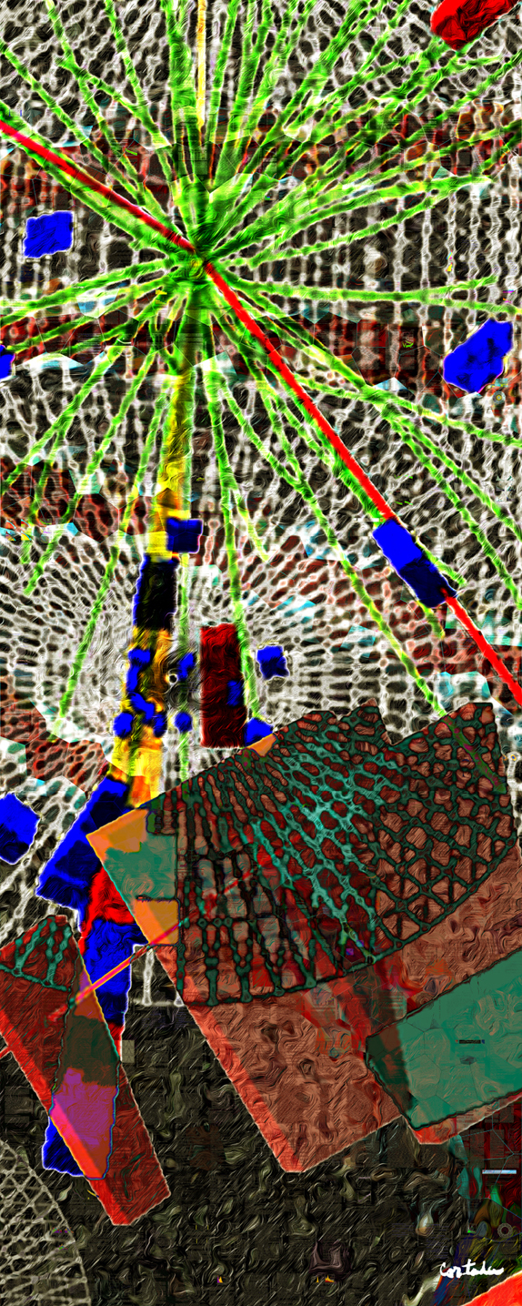
Diboson Physics and Triple Gauge Couplings
Digital art courtesy of Xavier Cortada (with the participation of physicist Pete Markowitz) "In search of the Higgs boson: H -> gamma gamma"

Slide 24
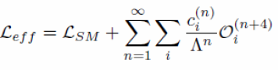
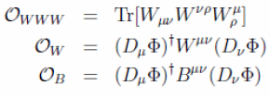





Effective Field Theory and Boson Interactions
For generic new physics effects descended from some high energy scale Λ, explore operator product expansion with Wilson coefficients c_i
Lowest dimension operators (dim 6, i.e. n=2) most important (assumes we are in perturbative regime for OPE).
Before EWSB, 5 gauge boson interaction terms respect gauge invariance (3 CP even + 2 CP odd)
After EWSB, induce correlated set of trilinear VVV’, VV’H, and quartic interactions.
At dim 6, expect WWγ, WWZ interactions (ZZZ or ZZγ are dim >=8) with 3 CP-even parameters (g_{1,} κ, λ)

Slide 25


WZ and Wγ Production
arXiv:1308.6832
CMS-PAS-SMP-12-006
CMS has thousands of high purity trilepton WZ candidates, tens of thousands of Wγ
Photon and lepton fakes are the predominant background
No evidence of new physics in high PT tails
Wγ,
γ PT
WZ trileptons,
Z PT

Slide 26




WW Production
arXiv:1306.1126
Phys. Lett. B 721 (2013) 190–211
Eur.Phys.J. C73 (2013) 2283
Thousands of candidates in dilepton channel
Leading lepton PT shows no anomalous contribution
WW leading lepton PT, 8 TeV
WW leading lepton PT, 7 TeV
Significant diboson signal in semileptonic channel
Higher BR and low background at high PT gives superior TGC constraint
W dijet mass, 7 TeV
W dijet PT,
7 TeV

Slide 27




Zγ and ZZ Production
arXiv:1308.6832
CMS-PAS-SMP-13-005
arXiv:1309.1117
Thousands of dilepton-photon events at 7 TeV agree with SM
MET-photon channel: Higher BR and low background at high PT gives superior TGC constraint
~300 ZZ to 4-lepton candidates observed at 8 TeV
Z and ZZ masses consistent with SM
Zγ → llγ
γ PT
Zγ →MET+γ
γ PT
ZZ → 4l
ZZ mass

Slide 28

CMS Electroweak Cross Section Summary

Slide 29

Charged aTGCs: World Summary
Best single LHC 7 TeV measurements equal LEP2 or Tevatron combinations
Semileptonic WW gives the best information on κ and λ, leptonic WW and WZ better for g.
LHC 8 TeV will provide 2-3X better constraints, eclipsing LEP2
W magnetic moment constrained to 1% level, electric quadrupole moment to 0.01% level

Slide 30

Charged aTGCs: World Summary
arXiv:1304.1151
HVV’ operators are also induced by dim 6 anomalous interactions → Higgs σBR’s also constrain aTGCs!
Full 8 TeV Higgs data has better constraining power than 7 TeV dibosons. 8 TeV dibosons should catch up.
Full Run 1 analysis should combine Higgs and diboson data in a consistent, multi-dimensionally correlated way

Slide 31


Neutral aTGCs: World Summary
7 TeV Zγ (vvγ) world-leading in ZZγ/Zγγ sensitivity
8 TeV ZZ (4l) world-leading in ZZZ sensitivity

Slide 32

Tribosons, VBS, and
Quartic Gauge Couplings
Digital art courtesy of Xavier Cortada (with the participation of physicist Pete Markowitz) "In search of the Higgs boson: H -> WW"

Slide 33

Effective Field Theory Revisited
SM has 4 EW quartic interactions (QGCs): WWWW, WWZZ, WWγγ, and WWZγ
Dim 6 OPE has QGC correlated with TGC→dibosons dominate their constraints
Suppose new physics is suppressed at Dim 6. Then Dim 8 OPE is leading contribution and many more terms respect gauge and custodial symmetries.
19 new quartic terms become relevant at Dim 8 with various contributions to 4 boson interactions. Neutral 4 boson vertices can be non-zero (ZZZZ, ZZZγ, ZZγγ, Zγγγ).
Explore QGCs in triboson production and vector-boson scattering (VBS) processes
New strong interactions (partially) responsible for EWSB at the TeV scale could also primarily manifest as anomalous VBS

Slide 34



WW QGC via two-photon production
First search for photon-photon scattering production of WW
WWγγ quartic gauge coupling one of the amplitudes
Two eμ events observed with no UE present
First quartic gauge coupling limits at LHC; WWγγ limit two orders better than LEP or Tevatron!
Forward proton tagging in Run 2 will improve sensitivity further
JHEP 1307 (2013) 116
Two photon production
of WW (s, t, and u channel)

Slide 35


Triboson search in WWγ and WZγ
CMS-PAS-SMP-13-009
Extend the semileptonic WW search by selecting a subset with a high PT photon (>30 GeV). Triboson final state is an admixture of QGC, TGC, and double radiative events

Slide 36


Triboson search in WWγ and WZγ
CMS-PAS-SMP-13-009
Dim 6 and Dim 8 operators will exhibit a high PT tail for the photon
Can interpret results in both dim 6 (k’s) and dim 8 (f’s) picture.

Slide 37




Triboson search in WWγ and WZγ
CMS-PAS-SMP-13-009
Photon PT exhibits no anomalous high PT tail
Cross section UL on SM triboson rate is 3.4XSM (<241 fb)

Slide 38

Quartic Gauge Couplings: World Summary
WWγγ constraint is now dominated by CMS exclusive WW production result.
WWZγ explored for the first time (f_{T,0}).
Present limits do not correspond to meaningfully high energy scales or perturbative, unitary coupling regime.

Slide 39


Towards VBS: VBF Z production
CMS-PAS-FSQ-12-035
Purely electroweak Z + 2 jets (interfering)
Comprehensive study of Z+forward dijet production at 7 and 8 TeV.
VBF Z one of the interfering amplitudes
Z+2jet events selected with “VBF topology”: large dijet mass, large dijet Δy
Small S/B enhanced with BDT selection exploiting all Z+2jet kinematics
5 sigma signal for electroweak Z+jet production observed, fully consistent with SM
TGC potential under study
σEWK = 226 ± 26 stat
± 35 syst fb
σVBFNLO = 239 fb

Slide 40



Towards VBS: WZ projections
ECFA study to understand WZ VBS production
Select 3 lepton events with “VBF dijet” (dijet mass > 600 GeV, |Δy| > 4
5 sigma SM observation expected with 185/fb@14 TeV
5 sigma anomalous dim 8 production at the 1 TeV scale possible in Phase 1 (2 TeV in Phase 2)

Slide 41
Summary
The LHC Run 1 dataset has provided an enormous range of opportunities to test the electroweak interactions.
W and Z physics provide precision tests of PDFs and NNLO QCD + NLO EWK calculations, with future potential to explore the precision electroweak sector as well.
The LHC is now the leading laboratory for exploring the gauge boson self-interactions.
Now poised to explore vector boson scattering phenomena and directly test electroweak symmetry breaking.

Slide 42
Backups

Slide 43

Effective Field Theory Revisited
Dim 6

